Slide 2
Outline
Collection of guidelines, war stories and techniques learned during the development of Warframe
Focus on multiplayer games (many techniques applicable to any game type), frequent updates, active community
Mostly PC centric (more diagnostics available to developers, but variety of hardware)
What this talk is not about
Notes:
Not about pre-release, in-house testing (extra diag tools, traffic recording etc)

Slide 3
Warframe
A cooperative third person online action game
3 platforms (PC, PS4 (launch title), XB1) + China (PC+PS4)
23+ millions accounts
Typical CCU ~45-50k+ (PC)
Weekly updates, frequent major updates (usually every 6-8 weeks)
Own technology stack (everything from low-level socket code to matchmaking, all 3 platforms)

Slide 4
Debugging multiplayer code
Debugging games is hard
Debugging a MP game - like multi core, but no idea what other cores are doing
Debugging a constantly evolving MP game...
...running across N operating systems and hardware configurations =
Notes:
Brian Kernighan – “Everyone knows that debugging is twice as hard as writing a program in the first place.”

Slide 5
Knowledge is power
Collecting bugs/crash information to a database of your choice
In most cases - extension of an internal system (unhandled exception handler, uploaded to a global server)
No longer shielded by publisher, can be overwhelming at first. Higher CCU = more crashes (1/32k chance -- seemingly crashing all the time)
Include important details in the bug itself (OS, 32/64-bit, CPU, account…) for easy filtering
Notes:
Getting hit by a lightning – 1/80k

Slide 6
Analyzing data
Do not guess -- build a system to analyze incoming cases
Can start small (e.g. “Top 10 crashes in the latest build”), keep adding details
“...there is no religious demagogue worse than an engineer arguing from intuition instead of data.”
Robert P. Colwell, The Pentium Chronicles

Slide 7
Our system
Top X most frequent crashes, can be filtered by category (networking, system, game, ...)
Cross referencing (past builds)
Crashes/hour graph for every build
Global stats – bug breakdown (intuition vs cold facts)
Guess how many one-off crashes we get?

Slide 8
Our system
Top X most frequent crashes, can be filtered by category (networking, system, game, ...)
Cross referencing (past builds)
Crashes/hour graph for every build
Global stats – bug breakdown (intuition vs cold facts)
Guess how many one-off crashes we get? ~80%! (good... and bad)

Slide 9
Our system
Top X most frequent crashes, can be filtered by category (networking, system, game, ...)
Cross referencing (past builds)
Crashes/hour graph for every build
Global stats – bug breakdown (intuition vs cold facts)
Guess how many one-off crashes we get? ~80%! (good... and bad)
Usually almost 30% of all crashes in the top 5 issues (4/5 of these tend to be in drivers/external DLLs these days)

Slide 10
Crash report – log file
Given 2 theoretical extremes, it’s better to log too much than not enough
Can always filter out noise, can’t materialize information that isn’t there
Avoid messages carrying only binary info. Rule of thumb: the more unusual situation – the more details
ID all the things (objects, messages, players)
If something goes wrong, does it provide enough information to figure out the reason?

Slide 11
Look for cracks between layers
State machines (matchmaking, mission flow, UI)
N systems interacting with each other
UI vs underlying code (triggering an activity just as something else starts/ends)
Clients connecting/disconnecting
Focus on patterns repeating in multiple log files (the more the better)
Modify the code locally to trigger the suspected problem
Notes:
Where 2 layers meet

Slide 12
Parsing logs
Eyeballing is hard, especially for long sessions (megabytes of text, multiple missions)
Simple Perl scripts FTW (congestion control, leaking objects). Even easier if interesting entries are marked clearly
A graph is worth a thousand words (or numbers…)

Slide 13
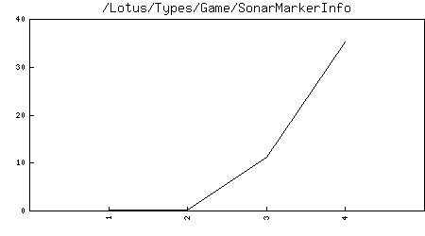
Object leaks
Object count (Y) vs time (X)

Slide 14
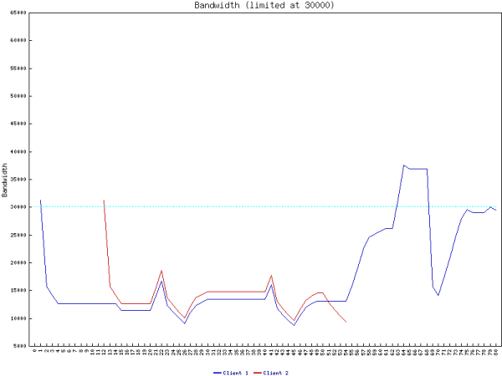
Congestion control tests

Slide 15
Crash report - dumps
Know your assembly (x64 tends to be easier to investigate, more registers). See [Ruskin11]
Immediate Window to the rescue (> + command, e.g. >~kb for callstacks for all threads)
Spider sense (e.g. reallocating std::vector while iterating)

Slide 16
Instrumenting crash dumps
In a perfect world, we’d just use full memory dumps. Sadly, they’re way too big for practical purposes (hundreds of megs),
“Mini” dumps include registers and the stack memory, helpful, but not always good enough
Can try to “exploit”, by storing important data on the stack (see blog post)
Better way: mini dump callbacks and request regions pointed by registers (if they look like valid addresses, can even chase pointers recursively)
Detecting type -- cast register to pointer, VS resolves vftables, e.g. (void**)eax - {Warframe.exe!const Projectile::`vftable'}

Slide 17
LogBug
Problem: crash we can work around, but the root cause remains a mystery. Examples: indexing out of bounds, state desynchronization
We can add more logging, but ideally we prevent users from crashing
Enter LogBug aka silent assertion. Logs an error message + a callstack, game keeps running, the error report dialog pops up when the app exits.
Result: game doesn’t crash, we get extra info (no dump, just log). 15 minutes of work to add on top of existing error handler.
Use sparingly, fix quickly (~15 active LogBugs in Warframe as of today)
Equivalent to fatal error for internal builds

Slide 18
Deploying to public
Low hanging fruit long gone, this is where the “fun” starts
Forget about trying to repro the bug just by playing a game (can still alter a build sometimes)
Left with good old fashioned police work. Given leads and clues, try to determine who’s the killer (or the reason for our bug)
Ability to quickly test various scenarios (unit tests) - invaluable!

Slide 19
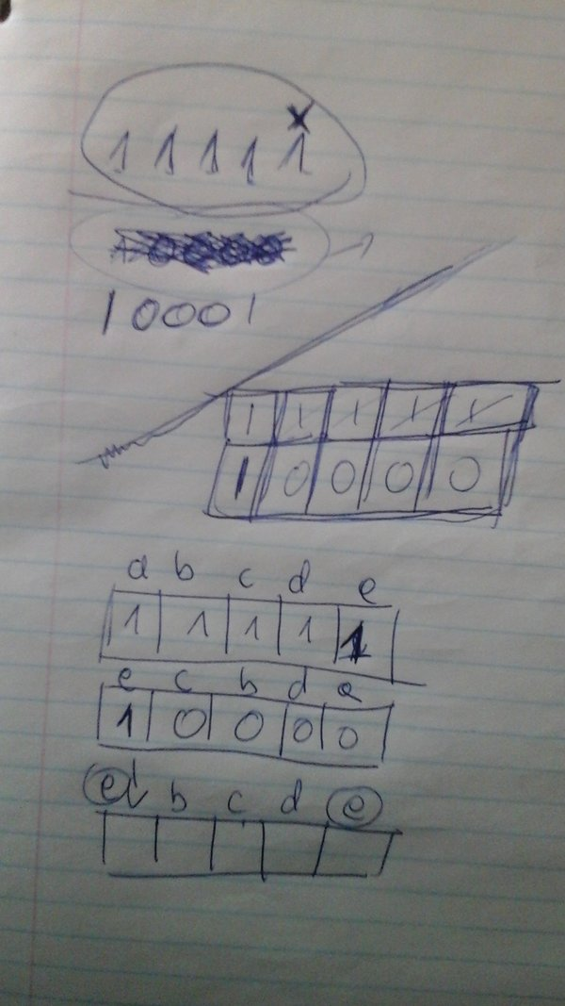
Chasing a suspect
Less stepping through code in a debugger, more pen & paper
War story: Warframe goes public, rare reports where a client crashes because host assumes he had received some information before (he didn’t)
It’s tempting to overcomplicate things, start with simple theories
Add “dimensions” rather than move along the same “axis”

Slide 20
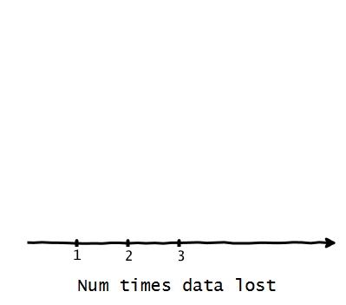
Adding dimensions
Moving along 1 axis modifies mostly probability, doesn’t expand our search space.

Slide 21
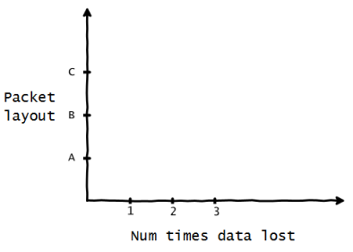
Adding dimensions
Adding a new dimension uncovers new possibilities
In our case - data dropped once, chunks it used to share a packet with retransmitted, but no space in the new packet for all original entries.

Slide 22
Example unit test
server = GetTypeMgr().Create<TestFrame>(); client = GetTypeMgr().Create<TestFrame>(); server->Initialize(true, "0.0.0.0:4950", false); const String& serverAddress = server->mNet->GetListenAddress(); client->Initialize(false, serverAddress, false); server->Update(0.1f); TEST(server->mNumConnects == 1); // 100% packet loss, 0ms latency client->mNet->SimulateNetwork(1.f, 0.f); server->mNet->SendData(...);
Controlled repro case, regression, documentation, verification (assumptions).
Notes:
“See Test X for details”
Both failing and succeeding tests valuable
Flow analysis

Slide 23
The aftermath
Very difficult to verify we got the right guy (no repro, remember?)
Publish a fix, hope for the best
Sometimes, an evil twin/copycat remains. Usually much easier now that we’ve a system/theory in place
Ideally, do not introduce major changes until the fix is verified (hard to attribute the cause otherwise)

Slide 24
LogBug strikes again
Eternal problem with networking – what was the other side doing at that time? We only get reports from the player who crash/encountered a problem
Some experiments with recording network messages (space limitations, still incomplete)
Solution: try to handle gracefully/convert to a LogBug and send a special message to the other player – “trigger LogBug”
Result: we get 2 (or more) reports from 2 machines (full log file with all the info we could think about). Have to find a matching pair (not everyone submits), but often any data from both sides is very helpful

Slide 25
Compiler bugs
“Never happens”...

Slide 26
Compiler bugs
“Never happens”... or does it?
Seemingly innocent code: m_v = Min(v, MAX_V); // Overloaded operator= contained _rotr16 intrinsic inside.
Getting reports of ‘v’ set to values greater than MAX_V
Generated (pseudo)assembly: mov r8d,MAX_V cmp edx,r8d ; edx=v, x86 -> flags as in sub edx,r8d ror ax,X ; X=1 for consistent repro, was other value cmovl r8w,dx ; r8 will be later stored in m_v
cmovl depends on OF & SF (move if OF!=SF)

Slide 27
Compiler bugs… and CPU differences
ROR instruction + the overflow flag:
Different behavior on different CPUs. i5-3320m laptop and i7-850 are “fine”, i7 2600k would modify the OF flag.
VS 2010, seems to be fixed in VS2012
The OF flag is defined only for the 1-bit rotates; it is undefined in all other cases [...] For right rotates, the OF flag is set to the exclusive OR of the two most-significant bits of the result. (Intel 64 and IA-32 Architectures Software Developer’s Manual, vol 2B)

Slide 28
Freezes/hitches
Need a way to grab the state of our process (a user friendly way!),
First approach: Process Hacker (just a callstack, no dump)
Better: procdump + batch file to make it a one-click operation: procdump process_name
Requires community help
Terrible granularity, but we’ve already diagnosed a few problems this way
Notes:
Process Hacker has an option to grab a dump, but it’s a full memory dump (considered modifying the source).

Slide 29
Community
Best community ever (no, really)
Community Testers (second layer)
Freezes/hitches
Network issues
Forums, IRC, voice chat

Slide 30
Third party libraries/external DLLs
Mostly beyond our control, but users blame you anyway (not your fault, but your problem)
Third party libs: report a problem, wait for a new version
External app: report a problem, detect and inform (video card software, various overlays)
Also: early console SDKs (especially paths less traveled). Staring at assembly code again
If you’re feeling brave, other options exhausted and you’re really bored: patching binaries by hand ([Sinilo13])

Slide 31
Acknowledgments
Warframe dev team
Warframe community

Slide 34
References
[Ruskin11] Ruskin, E. Forensic Debugging (GDC 2011)
[Sinilo13] Sinilo M., Patching binaries: http://msinilo.pl/blog/?p=1215

Slide 35
Extra Slides

Slide 36
Spider sense – dynamic arrays
Great container (std::vector & friends), but a few problems
push_back while iterating (often few levels down the call chain), can reallocate memory and invalidate iterators. Typical symptoms: crashing when trying to access memory pointed by an iterator
indexing out of range (in some cases easy to tell from the dump). In many cases fine to access it, but data doesn’t make sense, so fails later when trying to use it.

Slide 37
Spider sense - multithreading
Crash when reading/writing, data races
See what other threads are doing
Investigate all accesses, missing locks
Sometimes adding Sleeps makes it easier to repro (more likely for jobs to overlap on your fast computer)
Fake/failing locks - widen the race window, make it more obvious to detect concurrent access “Lock” = assert eq 0, set to 1 “Unlock” = assert eq 1, set to 0

Slide 38
Bugs – a social problem
No man’s land, “the bystander effect” (probability of help inversely related to the number of bystenders)
Situation a little bit better in a typical game team, not a problem with serious bugs
Cracks between layers again – problems when multiple modules overlap
Gamification: top issues lists, bounties
Systemic tweaks: clear responsibilities, encourage team members to move outside their comfort zones (especially new employees, one of the best ways to get familiar with the codebase)

